Slide 1
Hexagon SDK
-By Bhagya Lakshmi.M

Slide 2
Hexagon SDK
The Hexagon SDK is a collection of code generation and performance analysis tools designed to help developers enhance the features and performance of audio, speech, video, imaging and computer vision software on devices powered by Snapdragon™ processors.
The Hexagon SDK is also designed to enable high computational burdens on the CPU to be off-loaded into a heterogeneous computing environment with the use of shared remote code objects.
Qualcomm's Hexagon SDK enables you to run your code on the Hexagon DSPs. This is achieved by Computation Offload.
Computational offload:
Define your own API, implement that API for the Hexagon DSP, and call it directly from the application processor. This is accomplished using a Remote Procedure Call mechanism called FastRPC and dynamic loading.

Slide 3
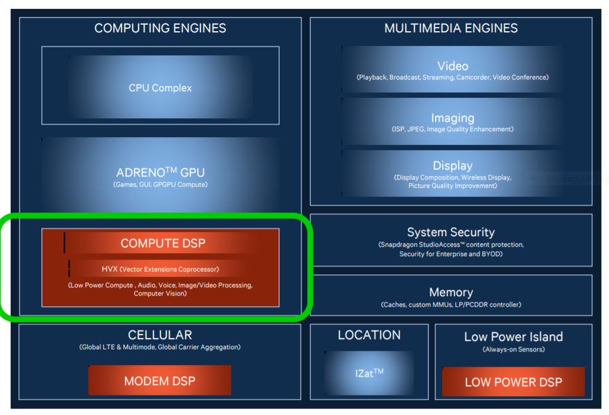
Hexagon DSPs in Snapdragon

Slide 4
What is CDSP?
CDSP( Compute DSP) intended for compute-intensive tasks such as image processing, computer vision, and camera streaming.
Compared to the host CPU, the DSP typically runs at a lower clock speed but provides more parallelism opportunities at the instruction level. This makes the DSP a better alternative to the CPU for power consumption. As a result, it is preferable to offload as many large compute-intensive tasks as possible onto the DSP to reduce the overall power consumption of the device.

Slide 5
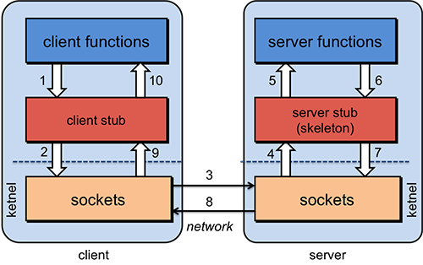
What is RPC?
Remote Procedure Call (RPC) is a protocol that one program can use to request a service from a program located in another computer on a network without having to understand the network's details.
RPC is used to call other processes on the remote systems like a local system. A procedure call is also sometimes known as a function call or a subroutine call.
RPC uses the client-server model. The requesting program is a client, and the service-providing program is the server.
fig: Remote Procedure Call

Slide 6
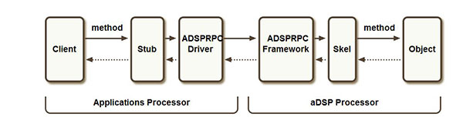
What is FastRPC?
The FastRPC framework allows for clients to transparently make remote method invocations between applications and DSP processors.
FastRPC architecture:
The below diagram depicts invocation of a single method where the client and object reside on different processors.

Slide 7
FastRPC
Client : User mode process that initiates the remote invocation
Stub : Auto generated code linked in with the user mode process that takes care of marshaling parameters
ADSPRPC Driver : ADSPRPC kernel driver that receives the remote invocation, queues them up and then waits for the response after signaling the remote side
ADSPRPC Framework : ADSPRPC framework dequeues the messages from the queue and dispatches them for processing
Skel : Auto generated code that takes care of unmarshaling parameters
Object : Method implementation. This is in the form of .so (shared object).

Slide 8
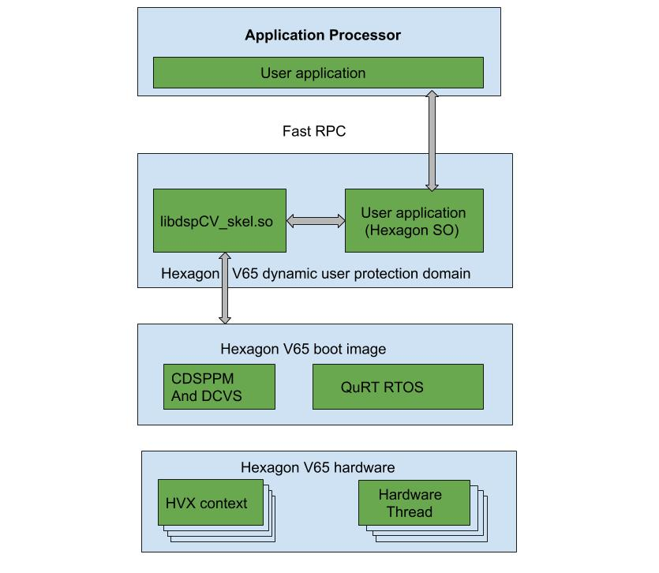
Architecture of Hexagon SDK

Slide 9
CDSPPM ( CDSP power management):
SDK provides APIs to control DSP core and bus clocks based on power and performance needs.
DCVS (dynamic control voltage scaling):
Based on user configuration, DCVS module in DSP (ADSP/CDSP) can adjust the core and bus clock frequencies based on core and bus usage.
HVX (Hexagon vector extensions):
Hexagon vector extensions are especially useful for achieving low-power,
high-performance imaging and machine learning algorithms.

Slide 10
What is IDL file?
The interface definition language (IDL) -- the specification language used to describe a software component's application programming interface (API) -- is commonly used in Remote Procedure Call software.
In calculator Example
Calculator.idl
This file present in below path.
C:\Qualcomm\Hexagon_SDK\3.5.2\examples\common\calculator\inc
#include "AEEStdDef.idl"
interface calculator {
long sum(in sequence<long> vec, rout long long res);
};

Slide 11
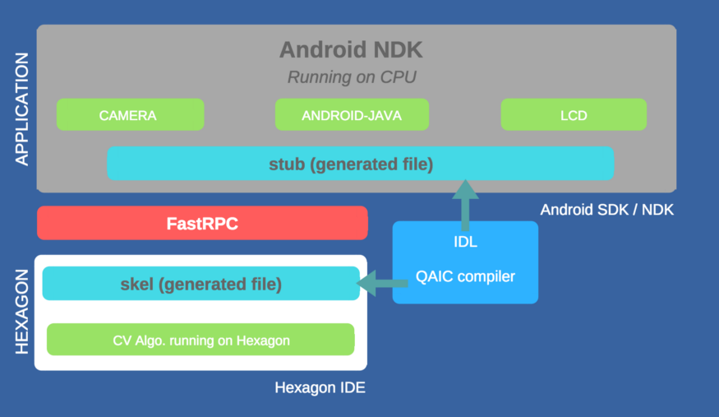
What is IDL file?

Slide 12
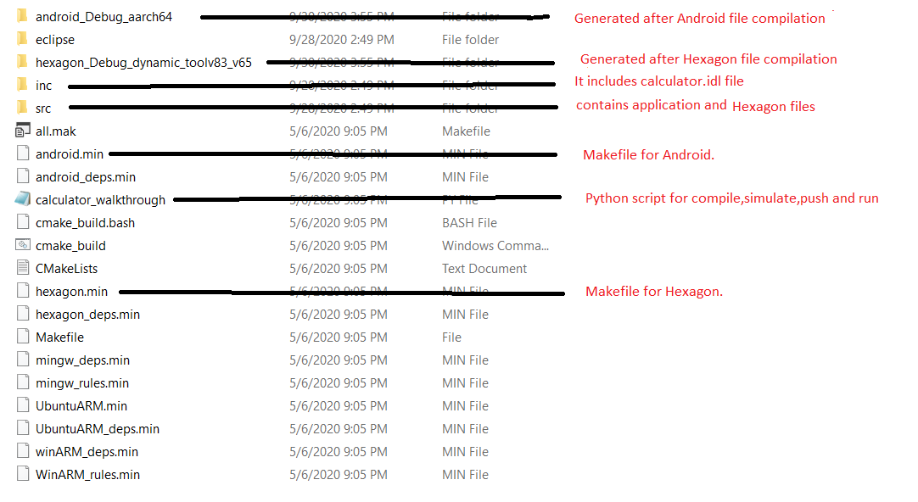
What is the folder structure in calculator example?

Slide 13
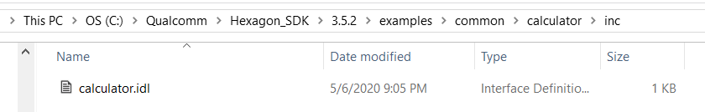
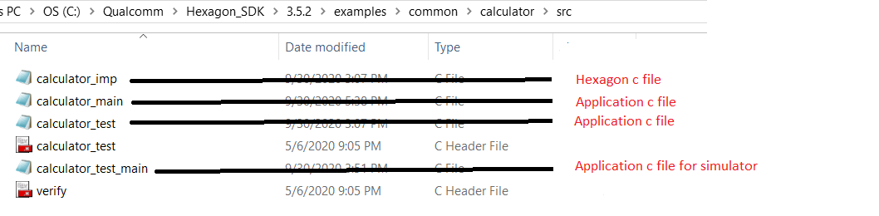
Where is IDL file & src files?
IDL file present in C:\Qualcomm\Hexagon_SDK\3.5.2\examples\common\calculator\inc
src files present in C:\Qualcomm\Hexagon_SDK\3.5.2\examples\common\calculator\src

Slide 14
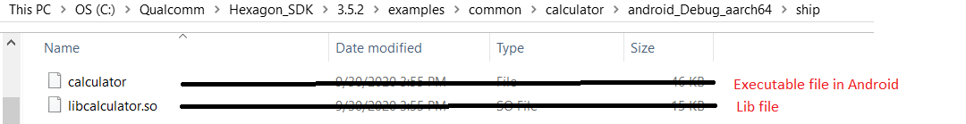
What are the libs/ executables generated? Where they generated?
In android.min
Generated library is: libcalculator.so
Generated Executable is: calculator
These are generated in C:\Qualcomm\Hexagon_SDK\3.5.2\examples\common\calculator\android_Debug_aarch64\ship

Slide 15
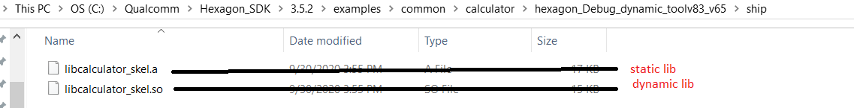
What are the libs/ executables generated? Where they generated?
In hexagon.min
Generated libraries are: libcalculator_skel.so , libcalculator_skel.a
Generated Executable is: calculator_q
These are generated in C:\Qualcomm\Hexagon_SDK\3.5.2\examples\common\calculator\hexagon_Debug_dynamic_toolv83_v65\ship

Slide 16
What is python walkthrough script? What it is doing? How to run?
walk-through script is a step by step guide to building, loading and executing the calculator example on Android.
Command for run python walk-through script is:
python calculator_walkthrough.py -T sdm845 -D cdsp
Walk-through script does:
1) Compile Application test app
2) Compile Hexagon Side library and
3) Run in simulator
4) Push the test app and libs into the device. into specific paths
App: vendor/bin/
Hexagon lib: /vendor/lib/rfsa/dsp/sdk/
5) Run the application

Slide 17
Explain individual commands ?
To setup sdk environment for windows candidate, you are required to execute the below command from your Hexagon SDK's root directory.
C:\Qualcomm\Hexagon_SDK\3.5.2>setup_sdk_env.cmd
1)compile Android test app:
Make clean for Android:
make tree_clean V=android_Debug_aarch64 CDSP_FLAG=1 VERBOSE=1
Make Android:
make tree V=android_Debug_aarch64 CDSP_FLAG=1 VERBOSE=1
2)Compile Hexagon Side library:
Make clean for Hexagon:
make tree_clean V=hexagon_Debug_dynamic_toolv83_v65 VERBOSE=1
Make Hexagon:
make tree V=hexagon_Debug_dynamic_toolv83_v65 VERBOSE=1

Slide 18
Explain individual commands ?
3)Simulaor command:
C:/Qualcomm/Hexagon_SDK/3.5.2/tools/HEXAGON_Tools/8.3.07/Tools/bin/hexagon-sim -mv65 --simulated_returnval --usefs hexagon_Debug_dynamic_toolv83_v65 --pmu_statsfile hexagon_Debug_dynamic_toolv83_v65/pmu_stats.txt --l2tcm_base 0xd800 hexagon_Debug_dynamic_toolv83_v65/calculator_q –

Slide 19
Explain individual commands ?
4) Push the libs into the device, into specific paths
---- Push Android components ----
Creating “/vendor/bin” in device and pushing calculator in “/vendor/bin” path.
adb shell mkdir -p /vendor/bin
adb push C:\Qualcomm\Hexagon_SDK\3.5.2/examples/common/calculator/android_Debug_aarch64/ship/calculator /vendor/bin
pushing libcalculator.so in “/vendor/lib64/” path
adb push C:\Qualcomm\Hexagon_SDK\3.5.2/examples/common/calculator/android_Debug_aarch64/ship/libcalculator.so /vendor/lib64/

Slide 20
Explain individual commands ?
---- Push Hexagon Components ----
Creating “/vendor/lib/rfsa/dsp/sdk/” path in device and pushing libcalculator_skel.so in ” /vendor/lib/rfsa/dsp/sdk/ ” path.
adb shell mkdir -p /vendor/lib/rfsa/dsp/sdk/
adb push C:\Qualcomm\Hexagon_SDK\3.5.2/examples/common/calculator/hexagon_Debug_dynamic_toolv83_v65/ship/libcalculator_skel.so /vendor/lib/rfsa/dsp/sdk/
---- Direct dsp messages to logcat ---
adb shell "echo 0x1f > /vendor/lib/rfsa/dsp/sdk/calculator.farf"

Slide 21
Explain individual commands ?
5) Run the application
---- Run Calculator Example Locally on Android ----
adb shell export LD_LIBRARY_PATH="/vendor/lib64/;" /vendor/bin/calculator 1 1000
---- Run Calculator Example on CDSP ----
adb shell export LD_LIBRARY_PATH=/vendor/lib64/:$LD_LIBRARY_PATH ADSP_LIBRARY_PATH="/vendor/lib/rfsa/dsp/sdk\;/vendor/lib/rfsa/dsp/testsig;" /vendor/bin/calculator 0 1000

Slide 22
Explain the logs?
calculator_imp.c:19:0x10ea:7: CDSP: =============== DSP: sum result 499500 ===============
This log is present in calculator_imp.c and it will display sum result of n numbers.
Where n is the input to command line arguments.
Output:
---Starting calculator test
---Allocate 4000 bytes from ION heap
---Creating sequence of numbers from 0 to 999
---Compute sum locally
Sum = 499500
---Success

Slide 23
Explain android.min (Android Makefile)?
ifeq ($(CDSP_FLAG), 1)
LIB_DSPRPC = libcdsprpc --->If CDSP is 1,we are taking lilibcdsprpc library
DEFINES += CDSP
else ifeq ($(MDSP_FLAG), 1)
LIB_DSPRPC = libmdsprpc
DEFINES += MDSP
else ifeq ($(SLPI_FLAG), 1)
LIB_DSPRPC = libsdsprpc
DEFINES += SLPI
else
LIB_DSPRPC = libadsprpc
DEFINES += ADSP
endif
$(info ************ LIB=$(LIB_DSPRPC) ************)
# stub library
BUILD_DLLS += libcalculator ---->Generating library name as libcalculator
libcalculator_QAICIDLS += inc/calculator ---->Including IDL files into libcalculator_QAICIDLS
libcalculator_C_SRCS += $V/calculator_stub ---->Including source files into libcalculator_C_SRCS
libcalculator_DLLS += $(LIB_DSPRPC) ---->Including CDSP lib to libcalculator_DLLS

Slide 24
Explain android.min (Android Makefile)?
# stand-alone calculator executable
BUILD_EXES += calculator --->Generating executable file as calculator
calculator_QAICIDLS += inc/calculator --->Including IDL files into calculator_QAICIDLS
calculator_C_SRCS += src/calculator_main src/calculator_test --->Including android source files into calculator_C_SRCS
calculator_LIBS += rpcmem --->Including rpcmem into calculator_LIBS
calculator_LD_FLAGS += -llog -ldl
calculator_DEFINES += VERIFY_PRINT_ERROR
# copy final build products to the ship directory
BUILD_COPIES = \
$(DLLS) \
$(EXES) \
$(LIBS) \
$(SHIP_DIR)/ ; ---->all generated build products will be in this path

Slide 25
Explain hexagon.min (Hexagon Makefile)?
# This builds the skel library
BUILD_LIBS += libcalculator_skel --->Generating static library name as libcalculator_skel
# only build the shared object if dynamic option specified in the variant
ifeq (1,$(V_dynamic))
BUILD_DLLS = libcalculator_skel --->Generating dynamic library name as libcalculator_skel
endif
libcalculator_skel_QAICIDLS = inc/calculator --->Including IDL files into libcalculator_skel_QAICIDLS
libcalculator_skel_C_SRCS += $V/calculator_skel --->Including source file into libcalculator_skel_C_SRCS
libcalculator_skel.C_SRCS = src/calculator_imp.c --->Including Hexagon source files into libcalculator_skel_C_SRCS

Slide 26
Explain hexagon.min (Hexagon Makefile)?
# quality test
BUILD_QEXES += calculator_q ---->Generaring executable file as calculator_q
calculator_q_C_SRCS = src/calculator_test_main src/calculator_test src/calculator_imp
--->Including Android & Hexagon source files to calculator_q_C_SRCS(simulator test)
calculator_q_LIBS = rtld rpcmem test_util atomic
# copy final build products to the ship directory
BUILD_COPIES = \
$(DLLS) \
$(EXES) \
$(LIBS) \
$(SHIP_DIR)/ ; ---->all generated build products will be in this path

Slide 27
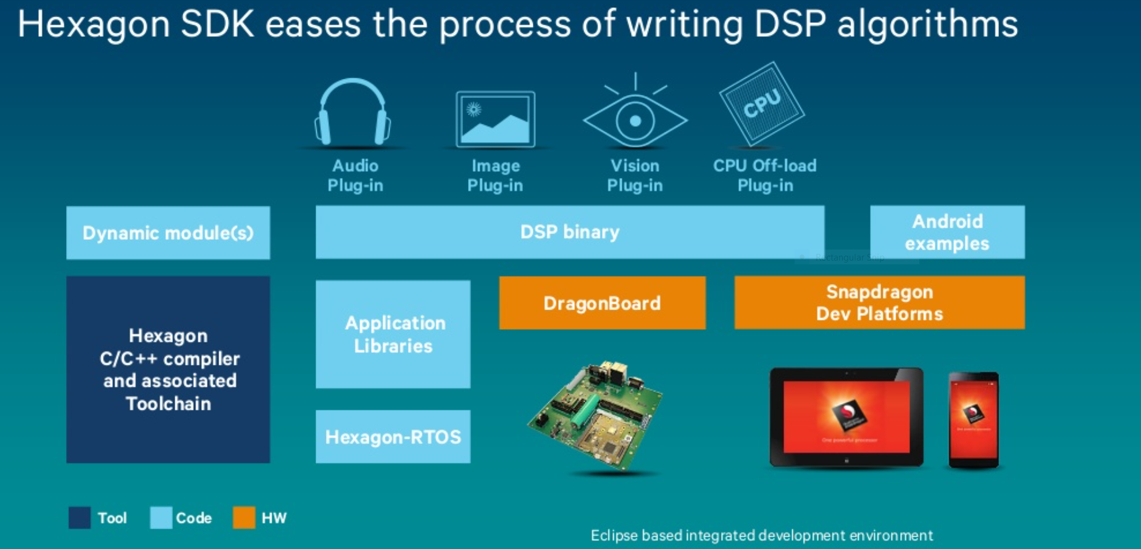

Slide 28
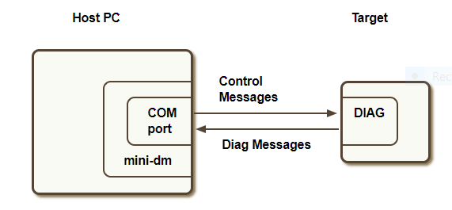
mini-dm
mini-dm.exe is the mini-diagnostic monitor provided by Qualcomm's Hexagon Access Program. It is a tool that displays diagnostic messages generated by the Hexagon DSP.
Diagnostic messages are generated by calling FARF on the DSP either from static or dynamic code
Connecting to a device:

Slide 29
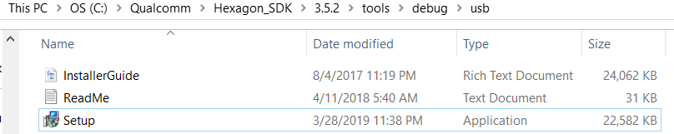
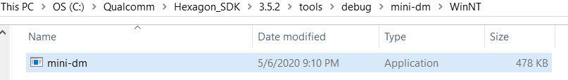
mini-dm
Hardware requirements
Target device
USB drivers ( For Windows: tools/debug/usb, For Linux: libusb is provided with SDK )
USB cable
Software requirements
mini-dm (tools/debug/mini-dm)

Slide 30

mini-dm
Steps to run mini-dm.exe
1)Install USB drivers (tools/debug/usb).
USB Driver Installation
For Windows:
USB drivers can be installed by running Setup.exe in tools/debug/usb directory
2)Power on the target device.
3)Connect the USB cable from the PC to the target device.
4)Open cmd promptand type:
5)Cd C:\Qualcomm\Hexagon_SDK\3.5.2\tools\debug\mini-dm\WinNT
6)mini-dm.exe —comport <port number>
Eg: mini-dm.exe —comport com3
Port number can be discovered by running the com_finder.py script.
Port number can also be discovered After pushing DSP split binaries on target and open Control Panel->Device manager-> Ports. The port number to consider is the one corresponding to the diagnostics port.
7)Play audio on the device or make a fastRPC call to generate messages
8)Diagnostic messages will start printing to console.

Slide 31
dspCV Library
Qualcomm's Hexagon SDK allows customers to develop DSP-accelerated Computer Vision applications on Hexagon V5 and later products via dynamic loading and FastRPC.
The dspCV dynamic library included in the SDK provides a set of APIs that allow a DSP thread to use its thread worker pool to invoke multiple callbacks in parallel. This approach enables one FastRPC call to turn into a multi-threaded DSP threads.
The dspCV library in ${HEXAGON_SDK_ROOT}/lib/fastcv/dspCV aims to abstract as much of the DSP runtime environment as possible, to reduce effort in offloading compute processing to the DSP. It offers API's to perform such functions as clock/power voting, multi-threaded callbacks, concurrency checking, and HVX resource management.

Slide 32
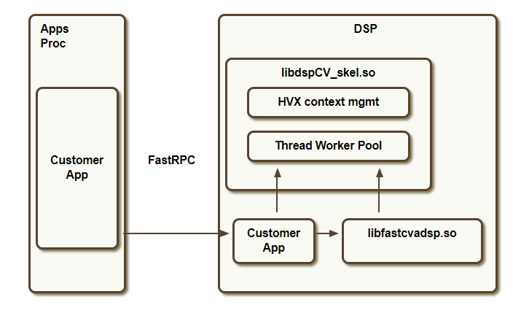
dspCV Library
fig: dspcv

Slide 33
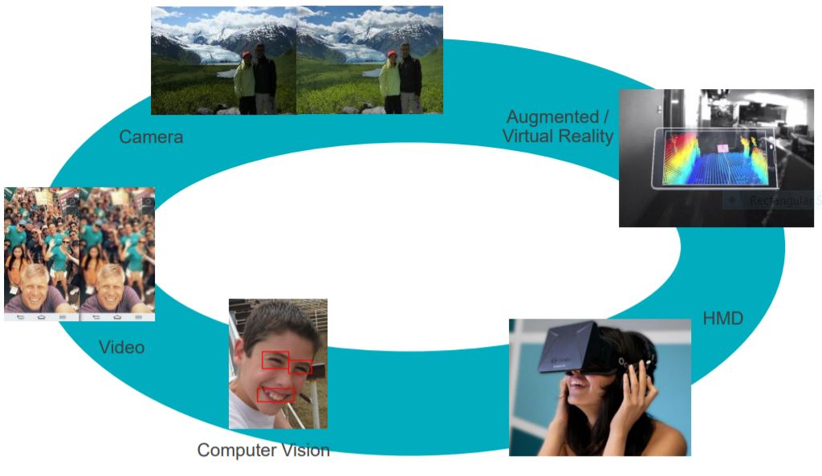
Hexagon Vector Extensions (HVX)

Slide 34
DownscaleBy2
If scaling factor is = ½
i.e, downscaling an image from W × H to (W ) × (H /2) .
Log analysis:
width=1920 and Height=1080
no of slipts=6
remaining rows=1080,900,720,540,360,180
rowsperjob =180
jobcount = 1,2,3,4,5,6
image srcstride :1920
image dstStride :1920
image srcHeight :180
total image size = 1920x1080
1 strip= 1920x180
2 same
3 same
|
|
6 same

Slide 35
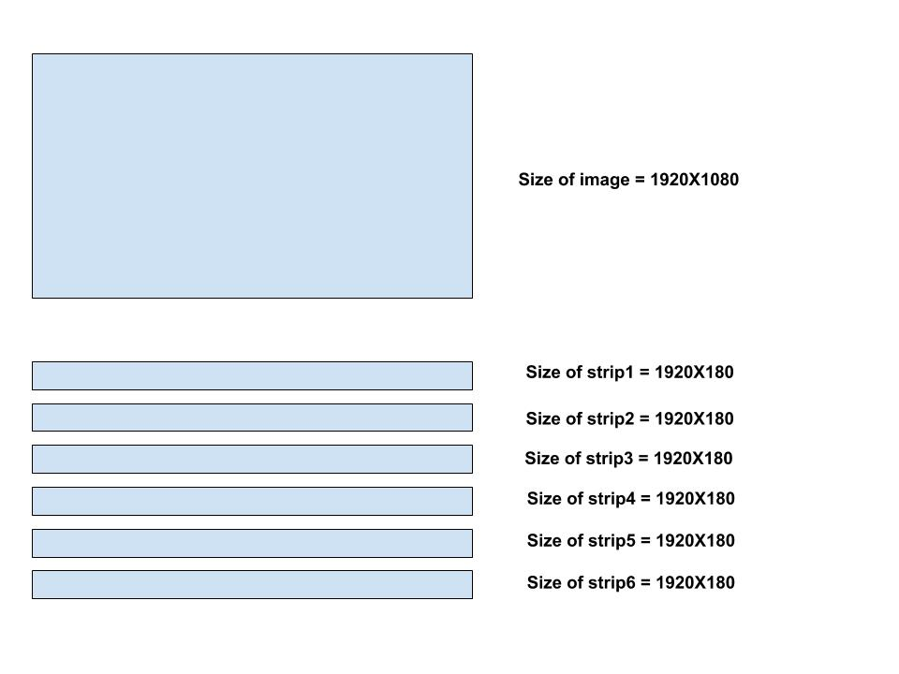
DownscaleBy2 (src image)

Slide 36
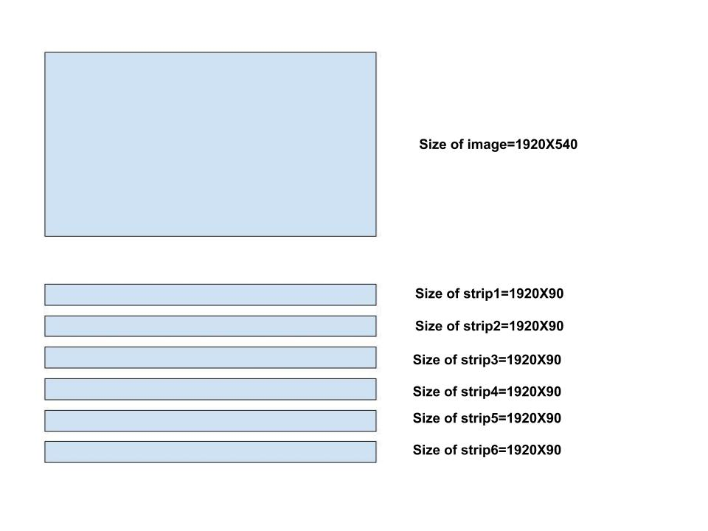
DownscaleBy2 (dst image)

Slide 37
DownscaleBy2
strip1 src address : E8400000
strip2 src address : E8454600
difference b/w src of stripe1 and src of stripe2 = (54600 -> hex),(345600 ->decimal)
345600 =(1920 * 180) ->so,stripe2 src = width of stripe1 * stripe1 height
strip1 dst address : E8600000
strip2 dst address : E862A300
difference b/w dest of stripe1 and dest of stripe2 = (2A300 -> hex),(172800 ->decimal)
172800 = (1920 * 90) ->so, stripe2 dst= width of stripe stripe1 * height/2

Slide 38
Benchmark
Benchmark is the practice of comparing performance with attributes .
In this example comparing attributes such as width and height of image, power level and time taken to execute etc.. for different filters.
Saving benchmark results to /data/local/benchmark.csv
adb pull /data/local/benchmark.csv

Slide 39
Benfits of Hexagon SDK:
Runs faster for reduce latency.
Runs with lower power.
Can run multiple processes at the same time.

Slide 40
Thank You

